Slide 1
Bank Account System
Student Leader Name: Sean
Group Name List: Lee, Shrek, Bruce, Lenny

Slide 2
This is our team.
Sean Lou
The CEO of the Bank System. Lead whole team to do their work better.
Bruce Guo
He is our Data Analyst in our team, who has finished read the account data job.
Lenny Luo
Graphic Architect. The GUI is beautiful or ugly, it all depends him.
Shrek Shen
Need deposit or withdraw? Just find our Accountant. With him, money is safe.
Lee Yao
No need for the account forever? Please find the Cancellation Manager.

Slide 3
Bruce Guo
Bank SYSTEM - data analyst

Slide 4
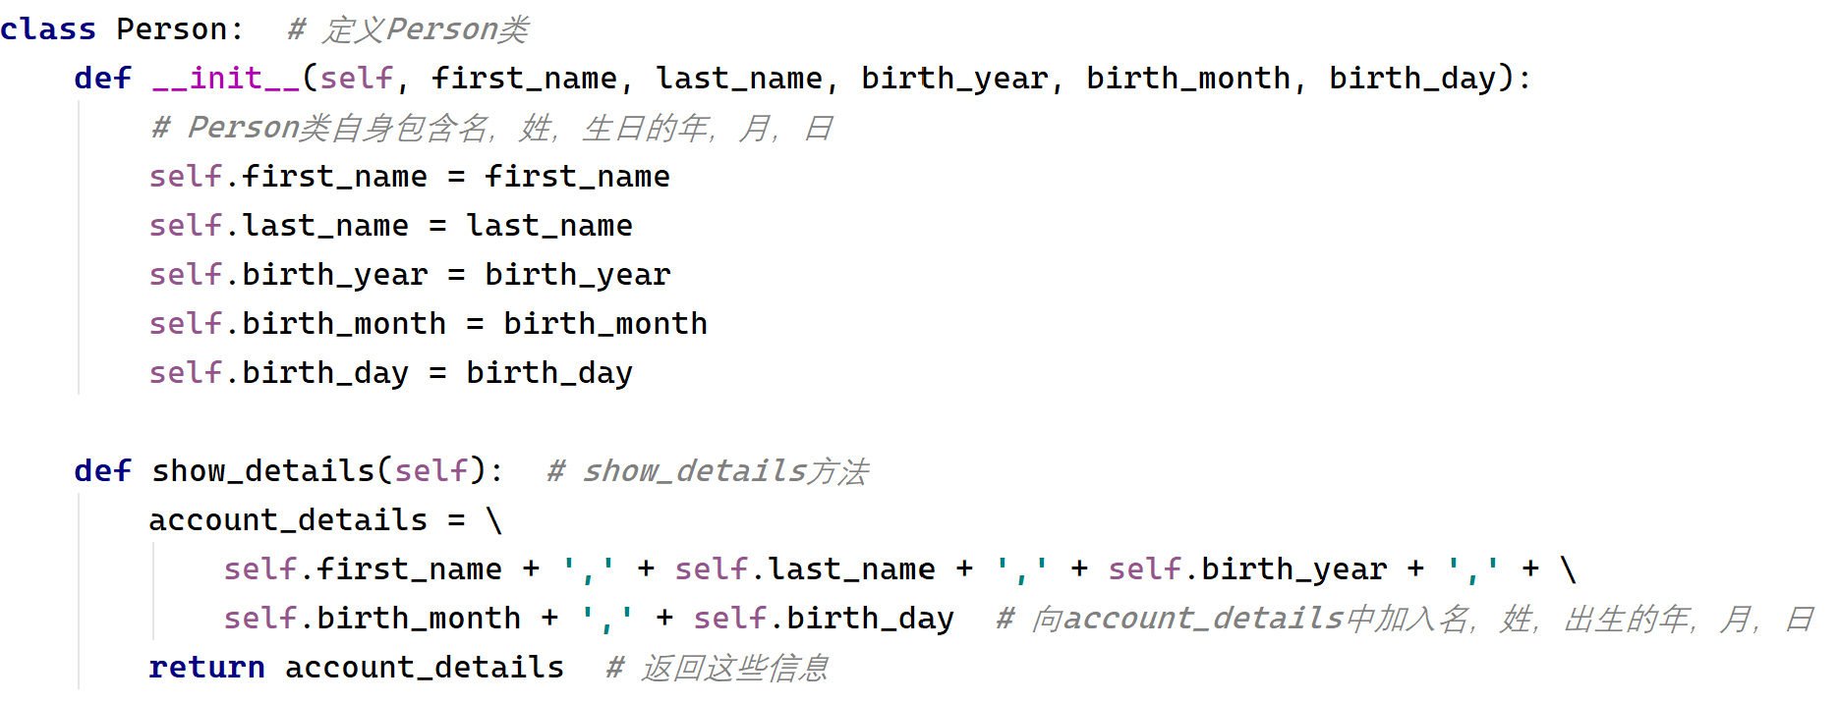
Data Define a class called Person.

Slide 5
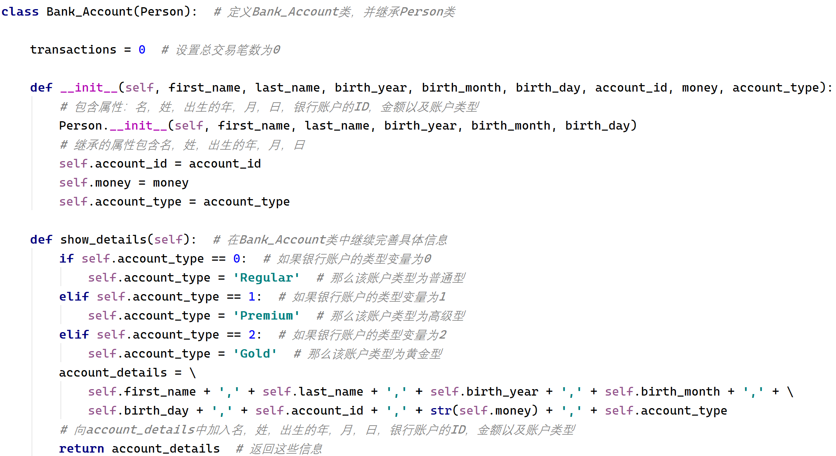
Data Define a class called Bank_Account.

Slide 6
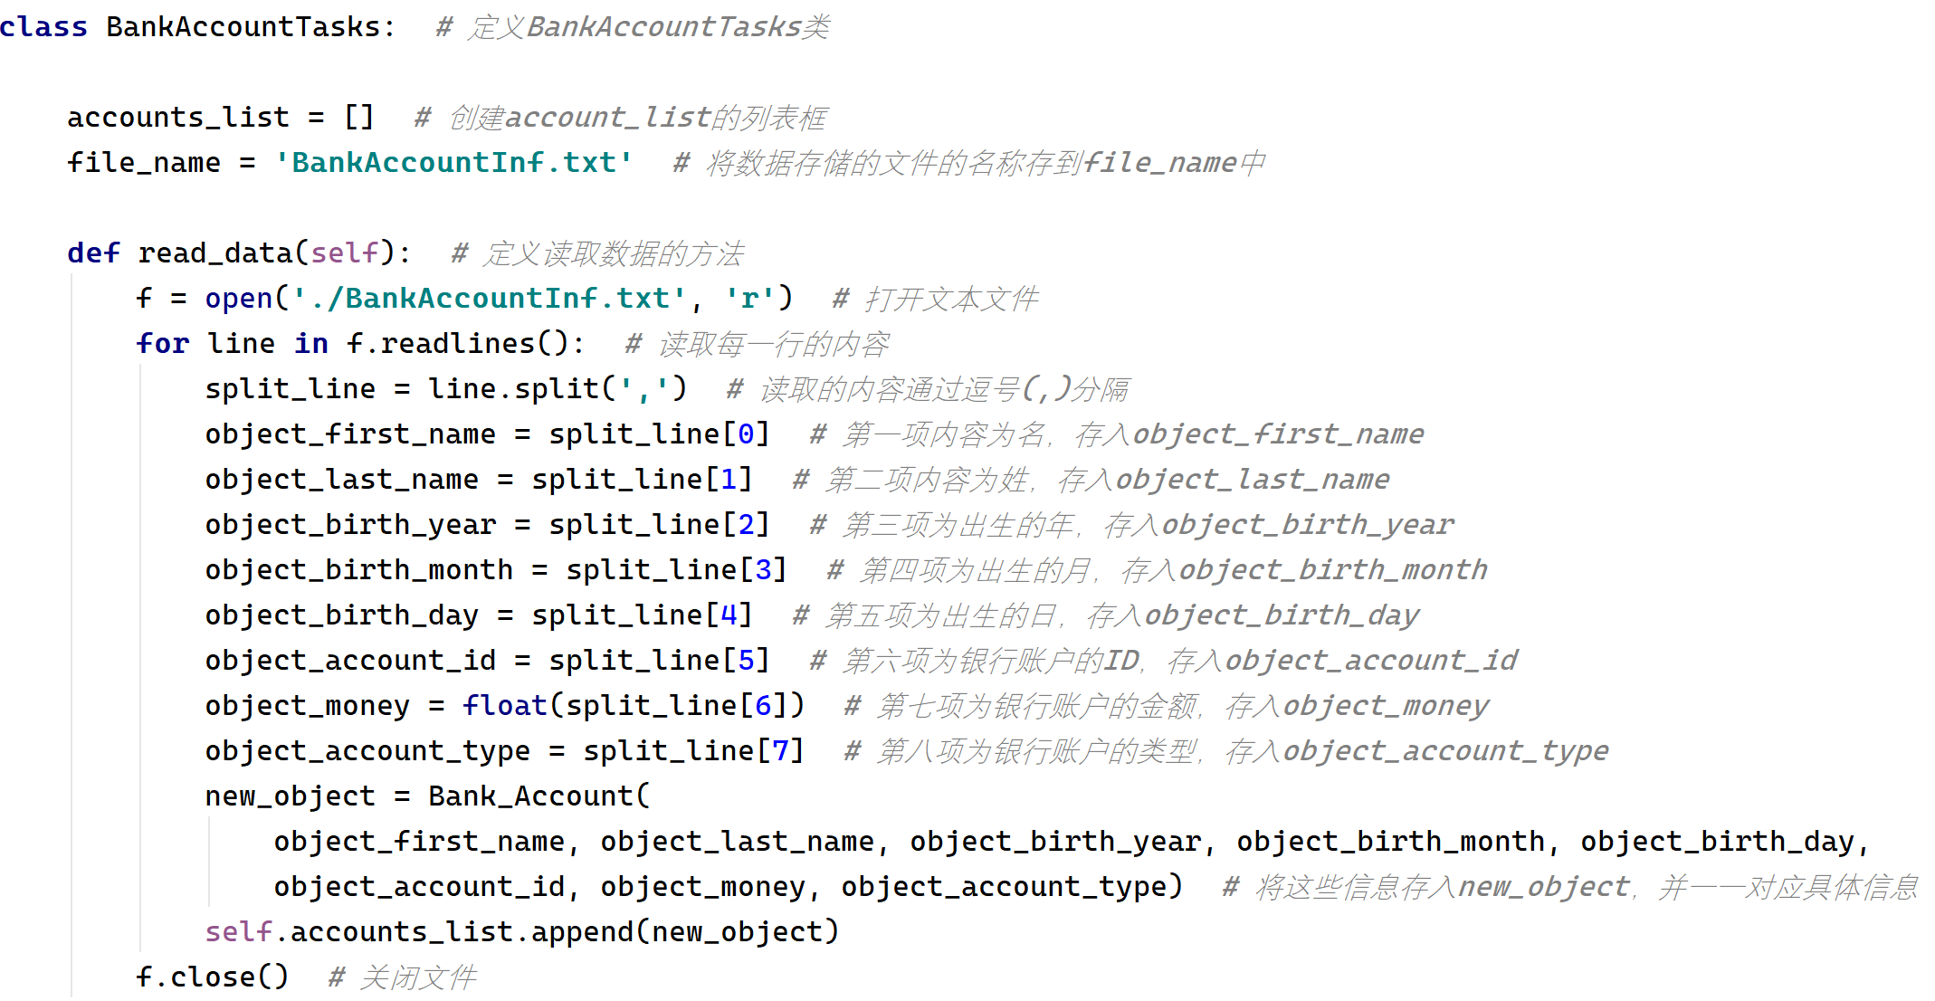
Data Define a class called BankAccountTasks.

Slide 7
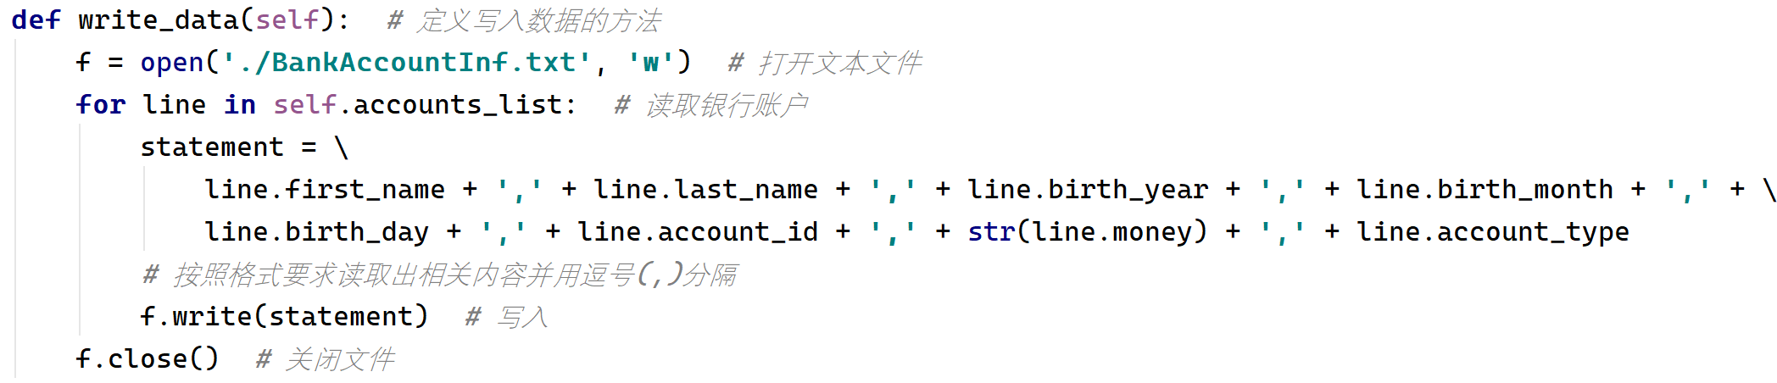
Data Define a class called BankAccountTasks.

Slide 8
Other
Some methods which are not declared in my part will be mentioned later.

Slide 9
Lenny Luo
BANK SYSTEM - Graphic architect

Slide 10
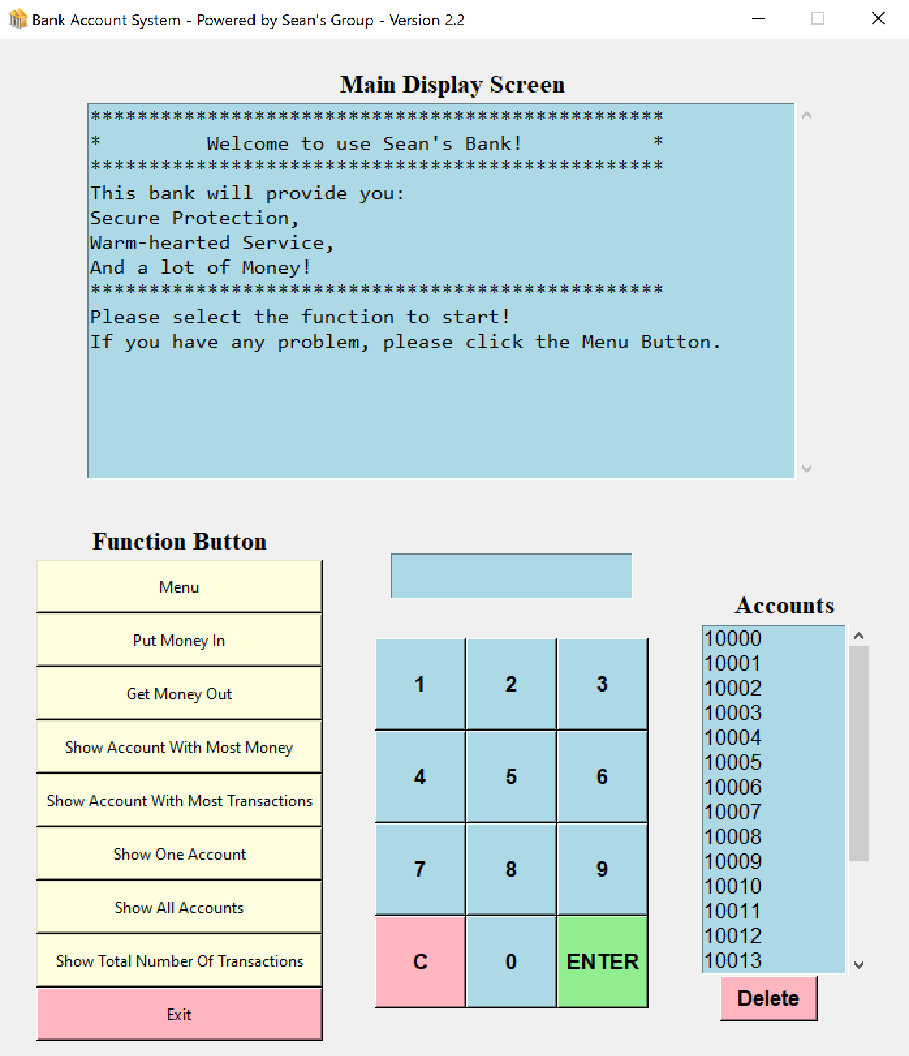
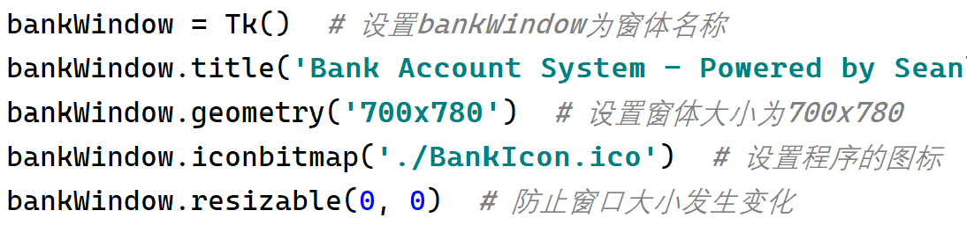
Window – Start The main properties of window.

Slide 11
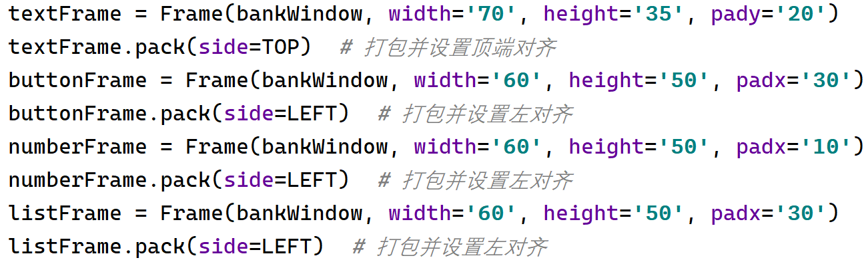
Frame 4 main Frame
Red: textFrame
Yellow: buttonFrame
Green: numberFrame
Blue: listFrame

Slide 12
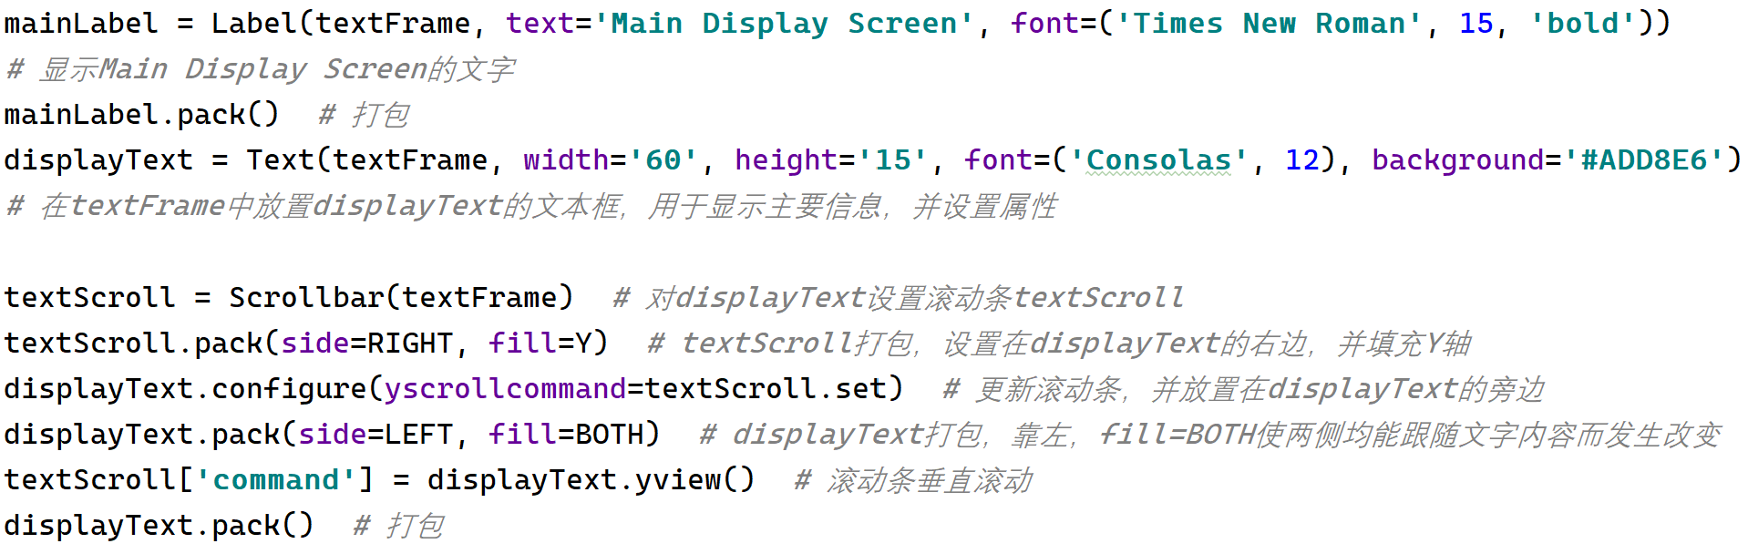
textFrame mainLabel, displayText, textScroll

Slide 13
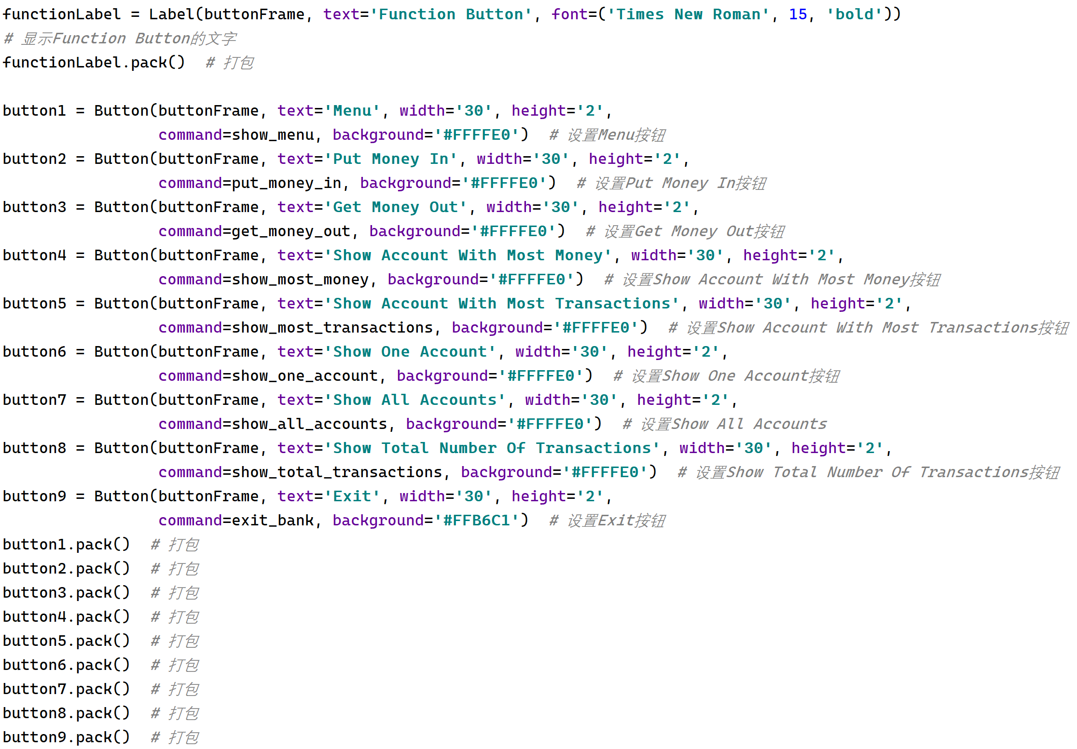
buttonFrame functionLabel, functionButton

Slide 14
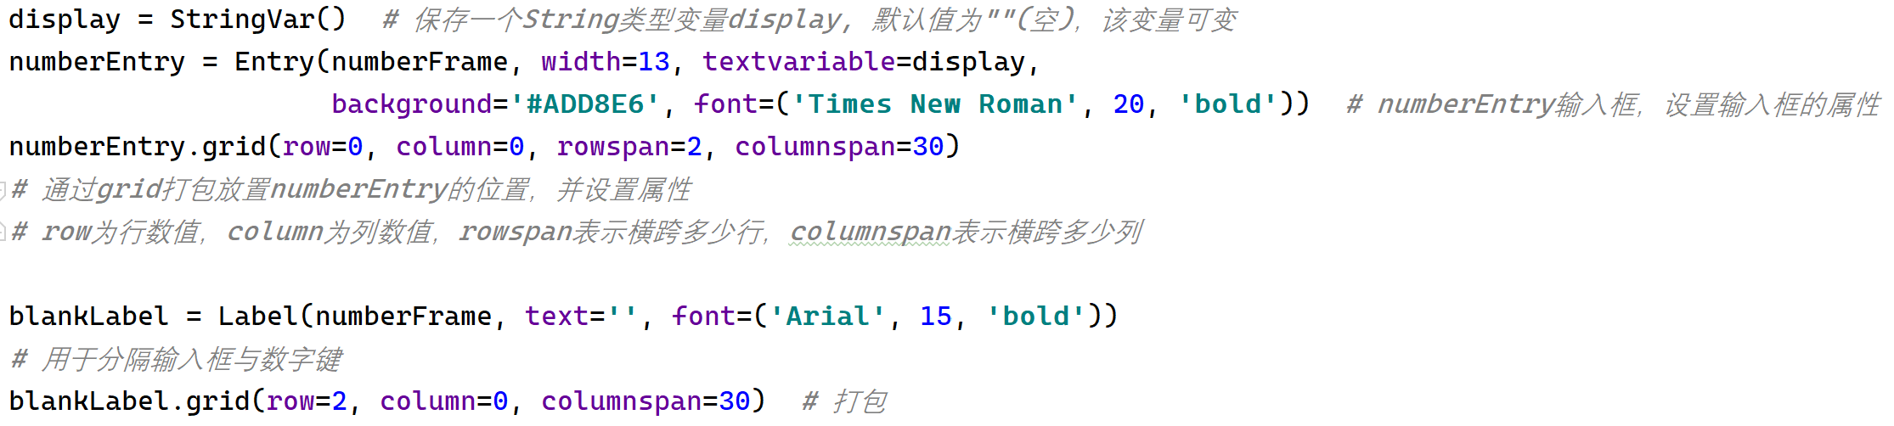
numberFrame numberEntry, blankLabel

Slide 15
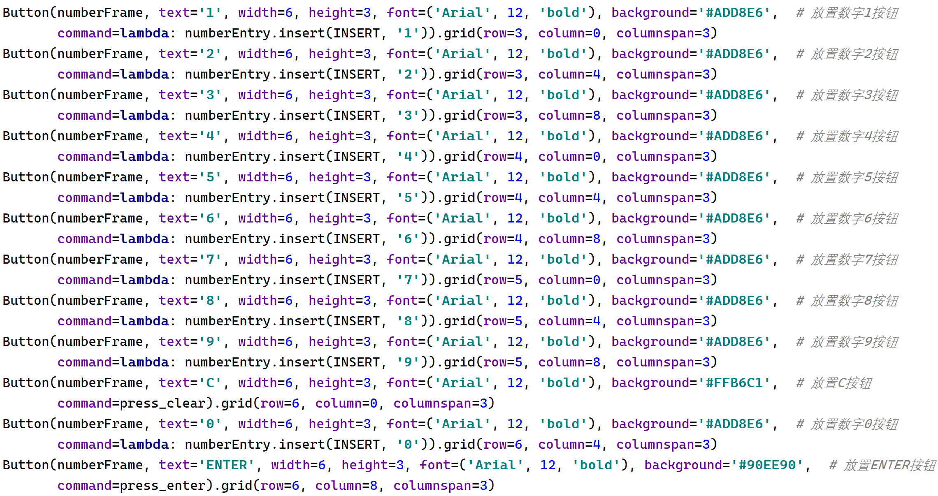
numberFrame numberButton0~9, C & ENTER

Slide 16
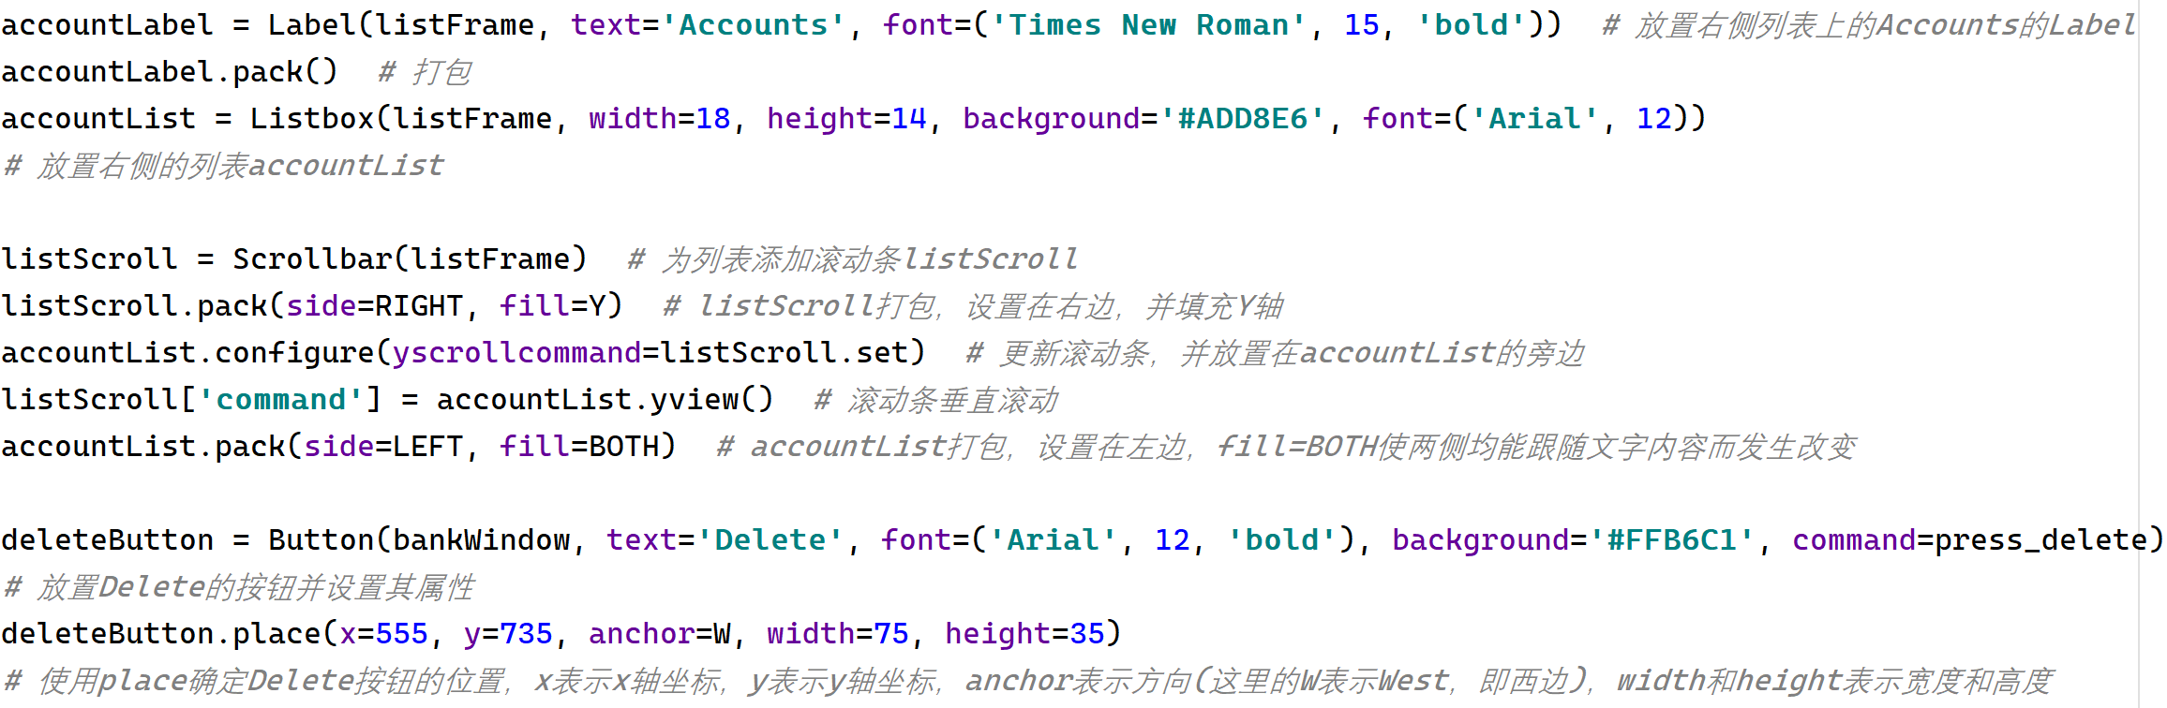
listFrame accountLabel, accountList, deleteButton

Slide 17
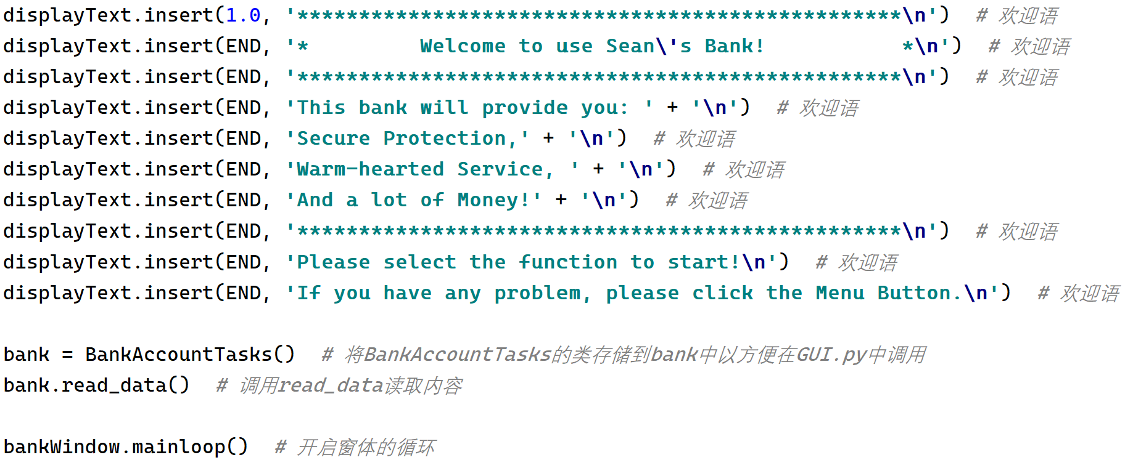
Window – End Include welcome information

Slide 18
Shrek Shen
BANK SYSTEM - Accountant

Slide 19
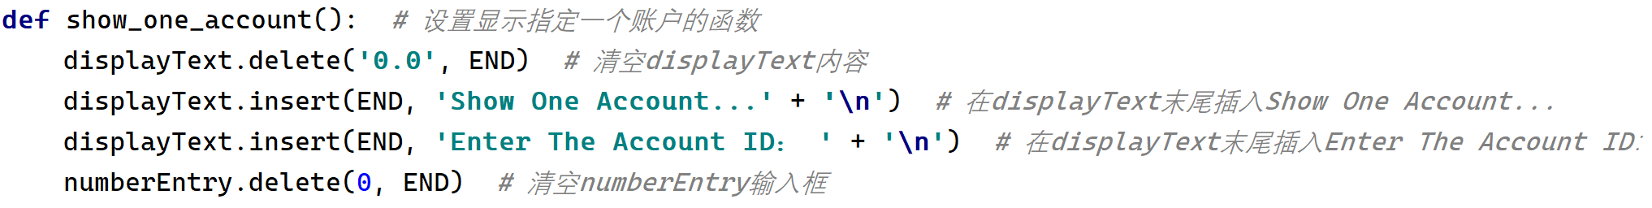
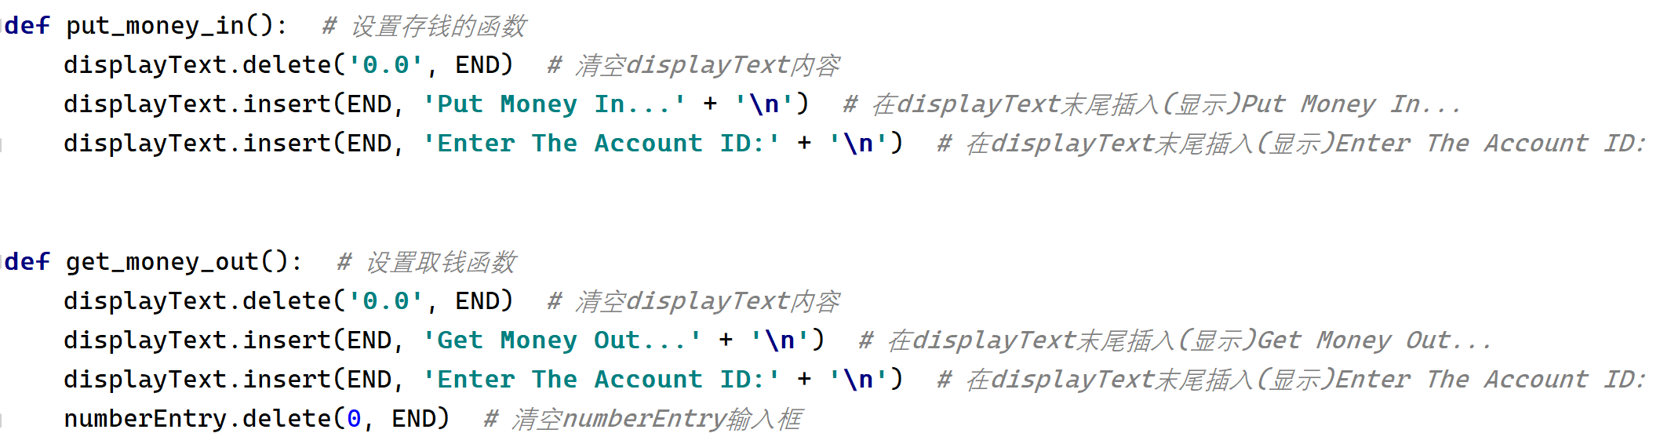
Function Show & Put & Get | Account or Money

Slide 20
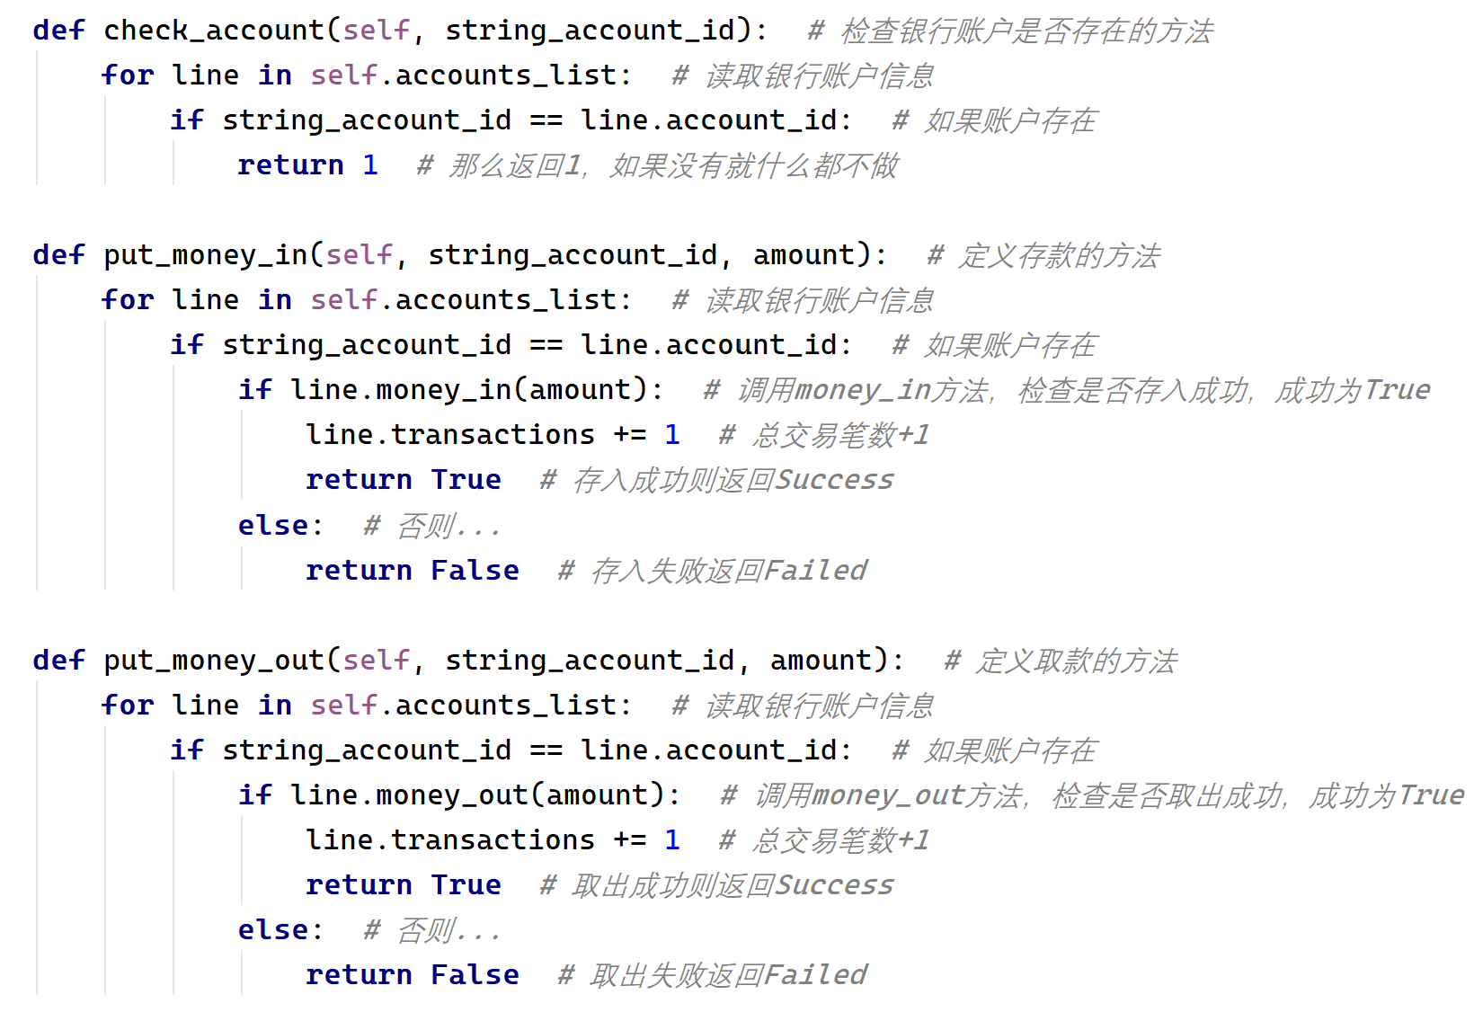
Function Introduce some method in Bank.py

Slide 21
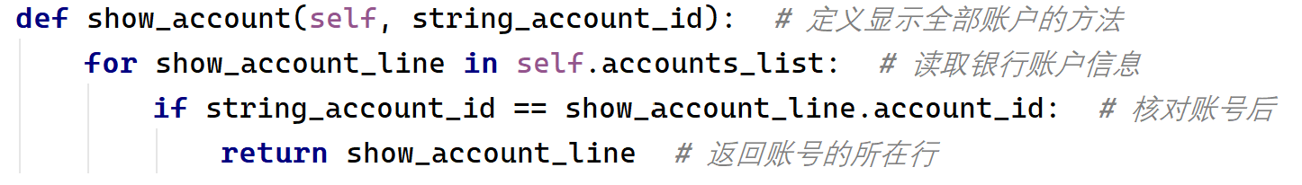
Function Introduce some method in Bank.py

Slide 22
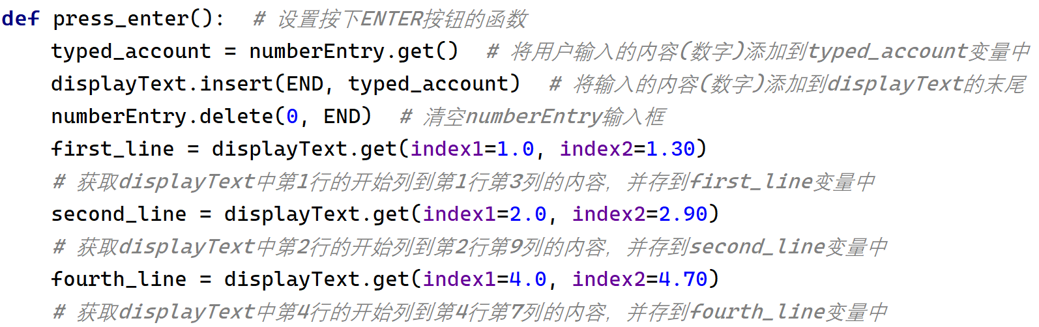
Function When you click ENTER button…

Slide 23
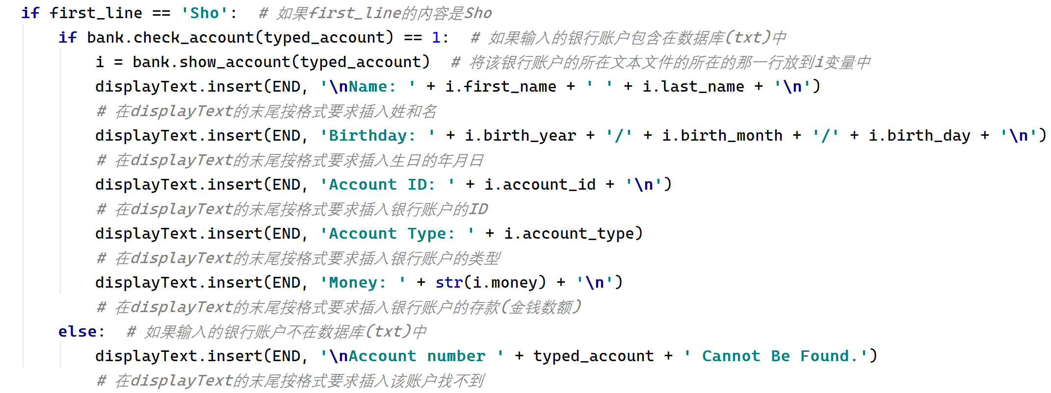
Function When you want to show account’s information…

Slide 24
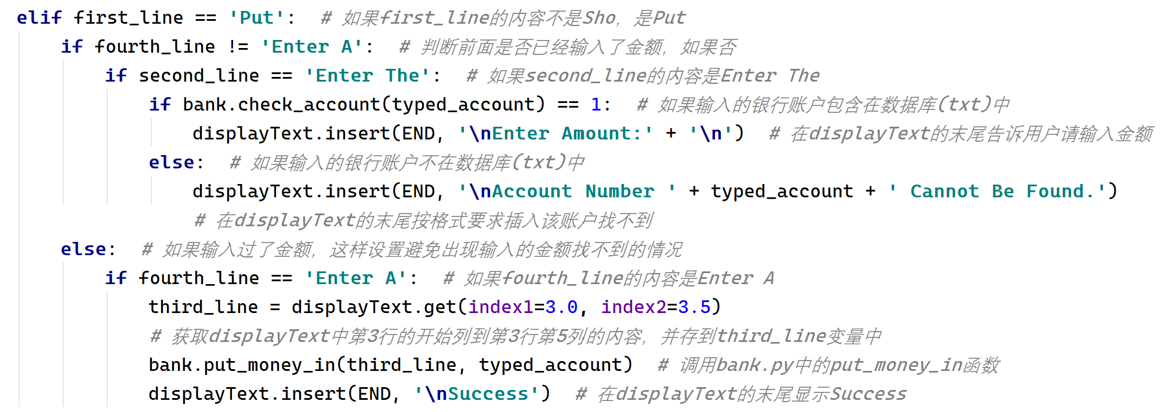
Function When you want to put money in…

Slide 25
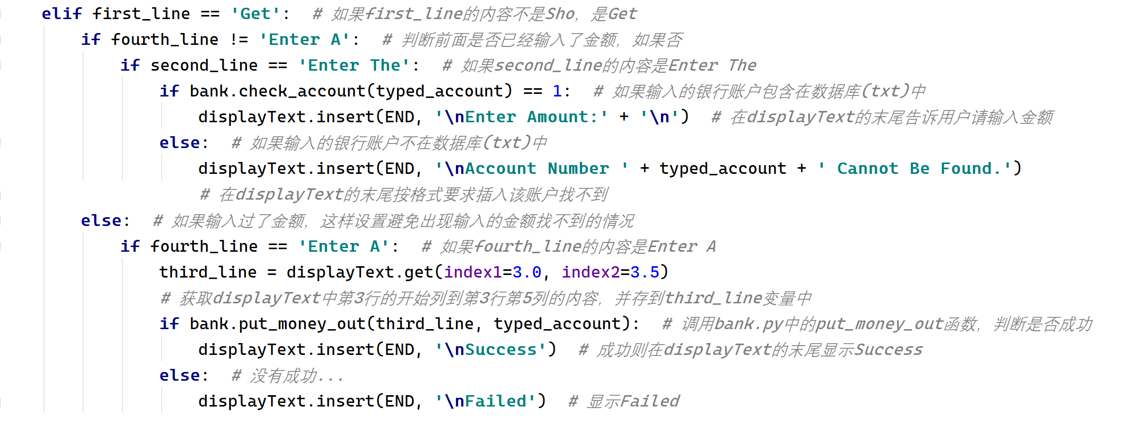
Function When you want to get money out…

Slide 26
Sean Lou
Bank system - CEO

Slide 27
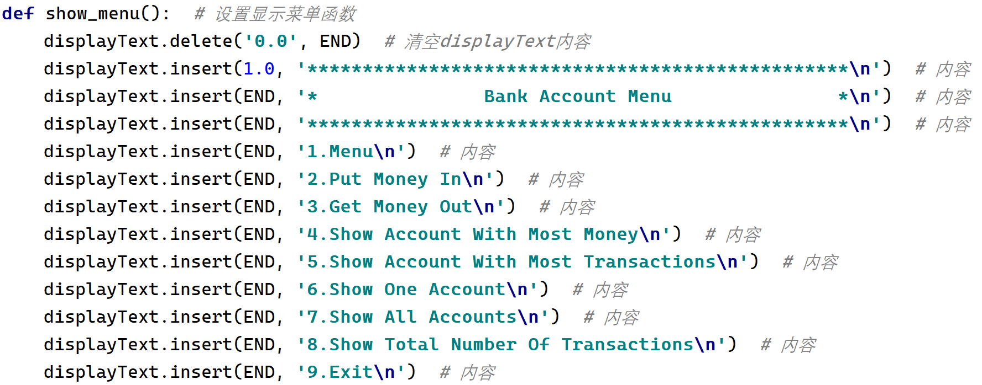
Function When you click Menu button…

Slide 28
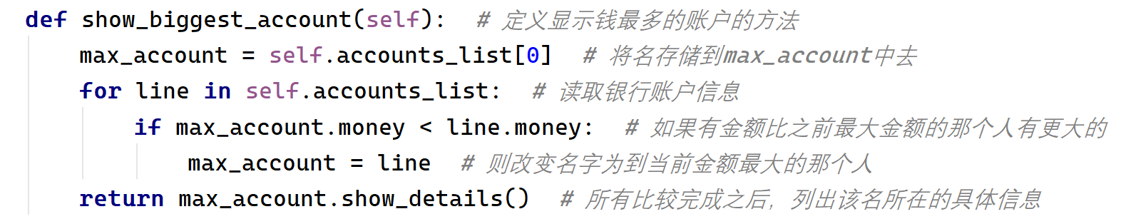
Function Show account with most money… (Bank.py)

Slide 29
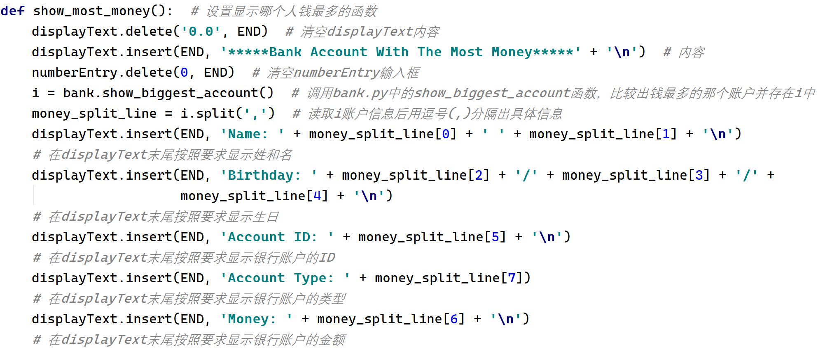
Function Show account with most money… (GUI.py)

Slide 30
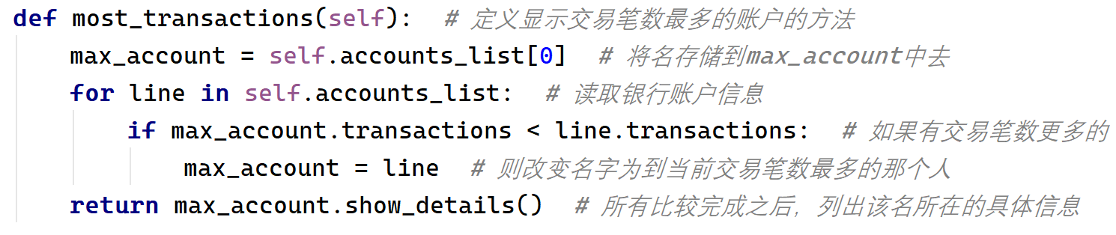
Function Show account with most transactions… (Bank.py)

Slide 31
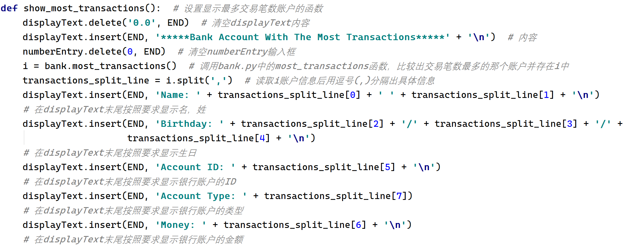
Function Show account with most transactions… (GUI.py)

Slide 32
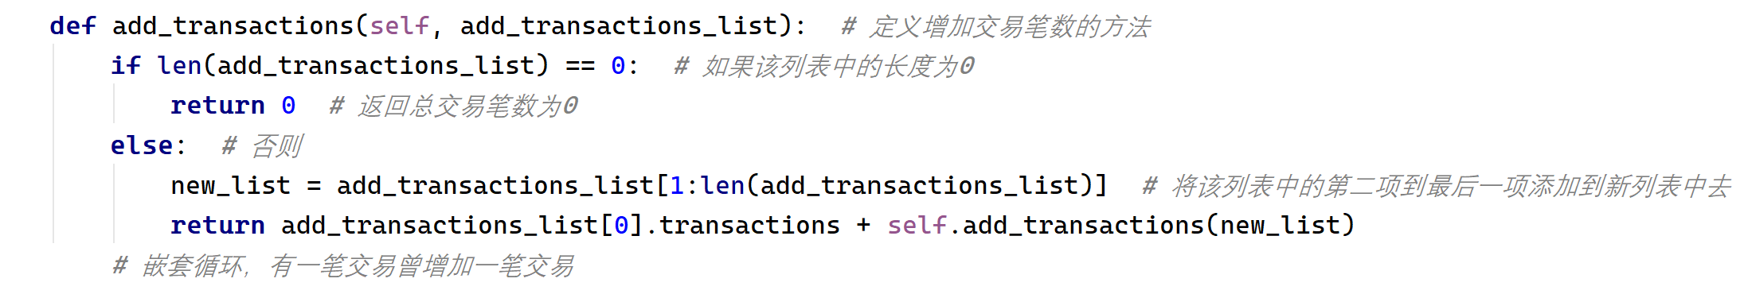
Function Show all accounts… (Bank.py)

Slide 33
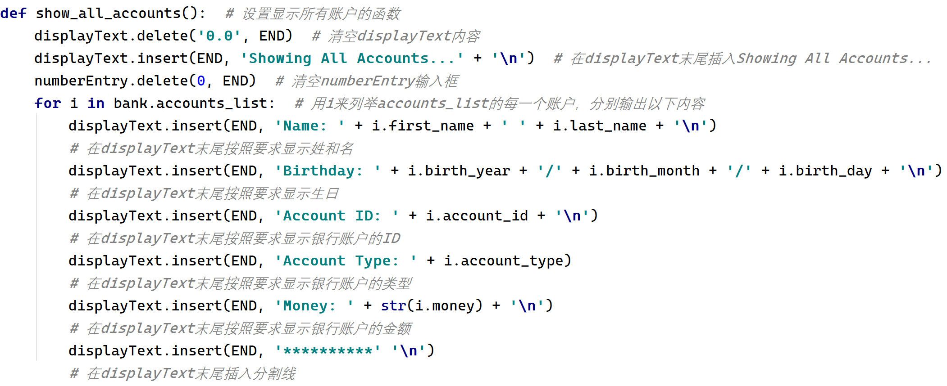
Function Show all accounts… (GUI.py)

Slide 34
Function Show total number of transactions… (Bank.py)

Slide 35
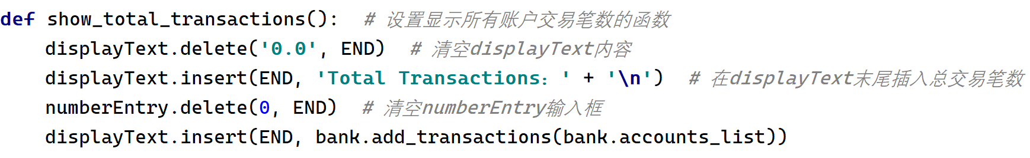
Function Show total number of transactions… (GUI.py)

Slide 36
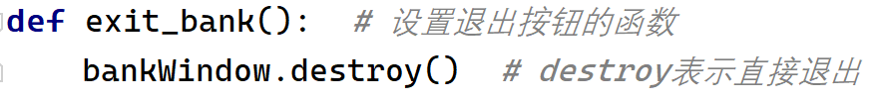
Function Exit this program.

Slide 37
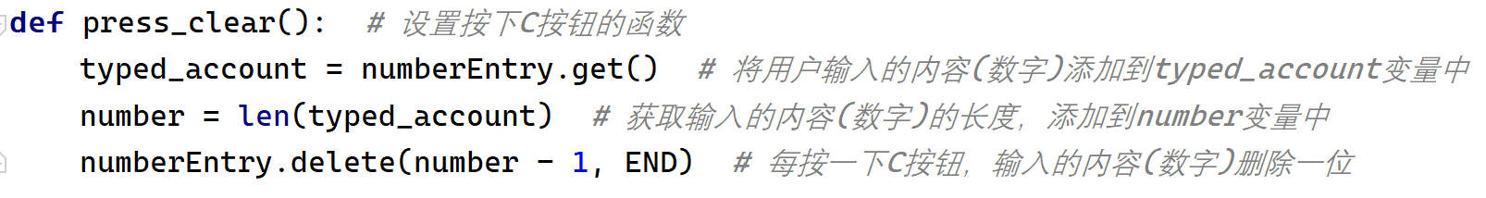
Function When you click the C button…

Slide 38
Function When you click the C button…

Slide 39
Lee Yao
Bank system – Cancellation Manager

Slide 40
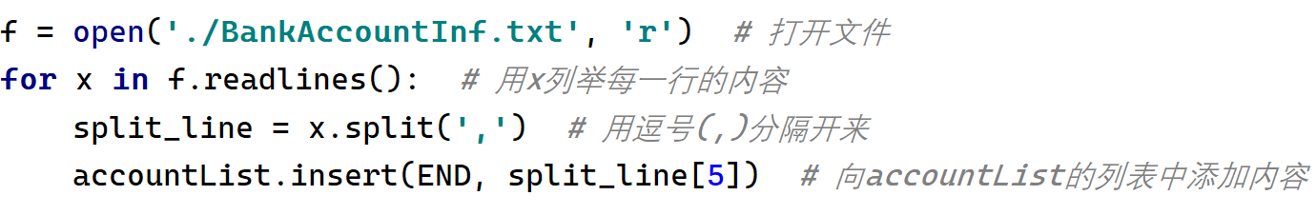
Data Add data to accountList.

Slide 41
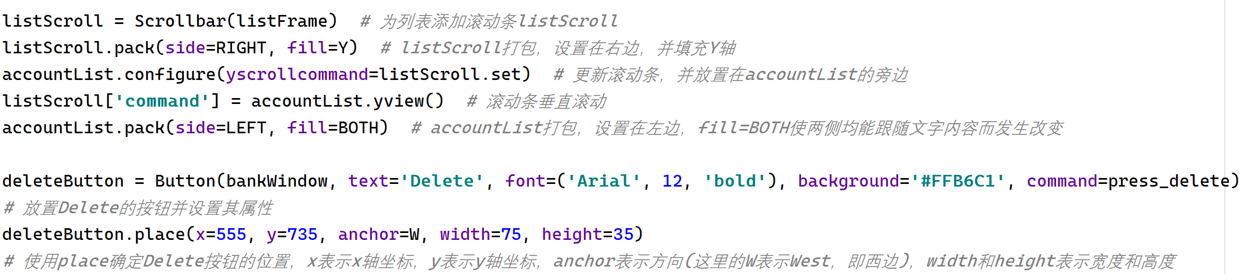
List In the listFrame…

Slide 42
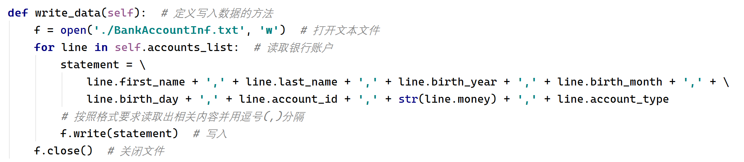
Write Data About the Delete button… (Bank.py)

Slide 43
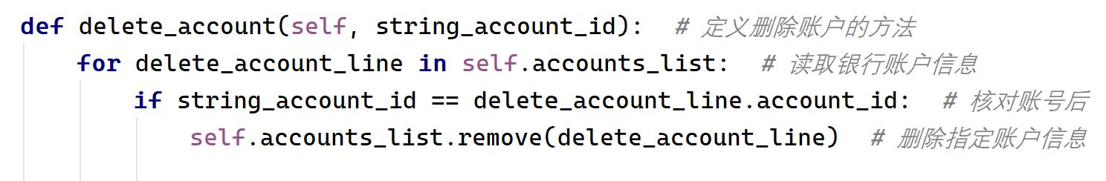
Delete About the Delete button… (Bank.py)

Slide 44
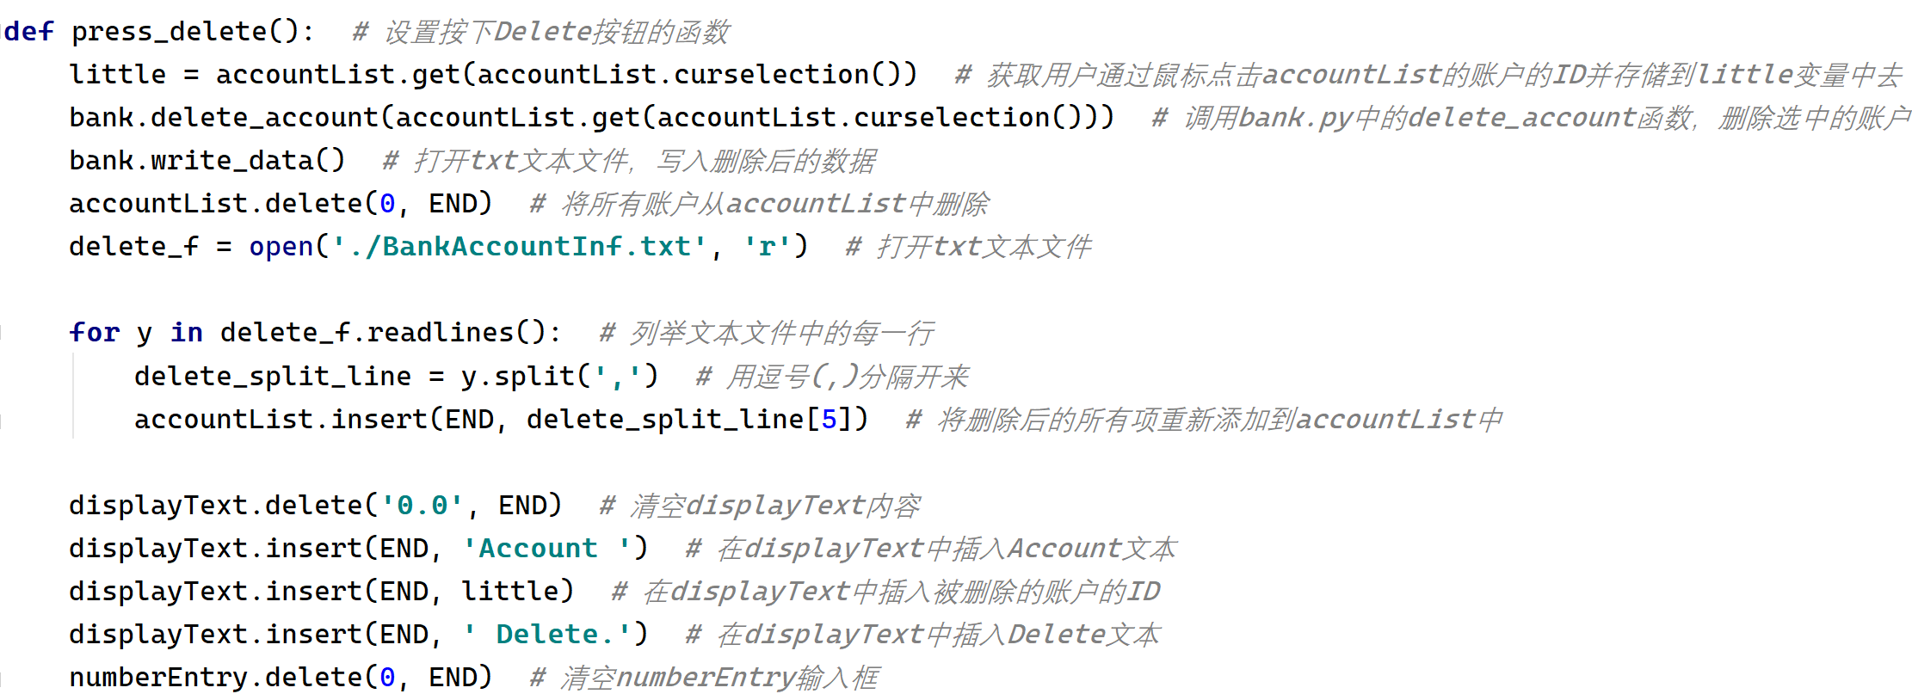
Delete About the Delete button… (GUI.py)

Slide 45
Thank you!
Let’s have a look our Bank System again!

